Slide 1
Wireless Sensor Networks
Unit 4

Slide 2
Topics
Wireless sensor networks Concepts
Basic architecture
design objectives and applications
Sensing and communication range
Coverage and connectivity;
Sensor placement;
Data relaying and aggregation;
Energy consumption;
Clustering of sensors;
Energy efficient Routing (LEACH).

Slide 3
Concept of WSN
Wireless Sensor Network (WSN) is an infrastructure-less wireless network that is deployed in a large number of wireless sensors in an ad-hoc manner
Used to monitor the system, physical or environmental conditions.
Sensor nodes are used in WSN with the onboard processor that manages and monitors the environment in a particular area.
Nodes are connected to the Base Station which acts as a processing unit in the WSN System.
Base Station in a WSN System is connected through the Internet to share data.

Slide 4
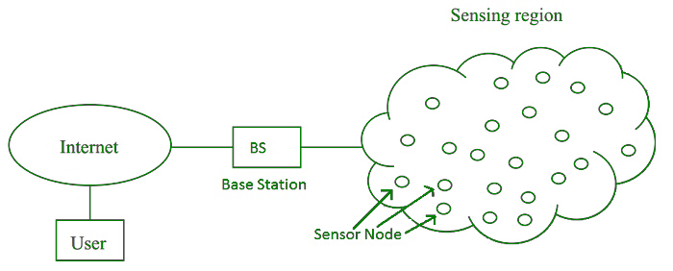
WSN-Components
Sensors: Sensors in WSN are used to capture the environmental variables and which is used for data acquisition.
Radio Nodes: It is used to receive the data produced by the Sensors and sends it to the WLAN access point. It consists of a microcontroller, transceiver, external memory, and power source.
WLAN Access Point: It receives the data which is sent by the Radio nodes wirelessly, generally through the internet.
Evaluation Software: The data received by the WLAN Access Point is processed by a software called as Evaluation Software for presenting the report to the users for further processing of the data which can be used for processing, analysis, storage, and mining of the data.

Slide 5
WSN Components
A typical wireless sensor network can be divided into two elements. They are:
– Sensor Node
– Network Architecture
A Sensor Node in a WSN consists of four basic components. They are:
– Power Supply
– Sensor
– Processing Unit
– Communication System

Slide 6
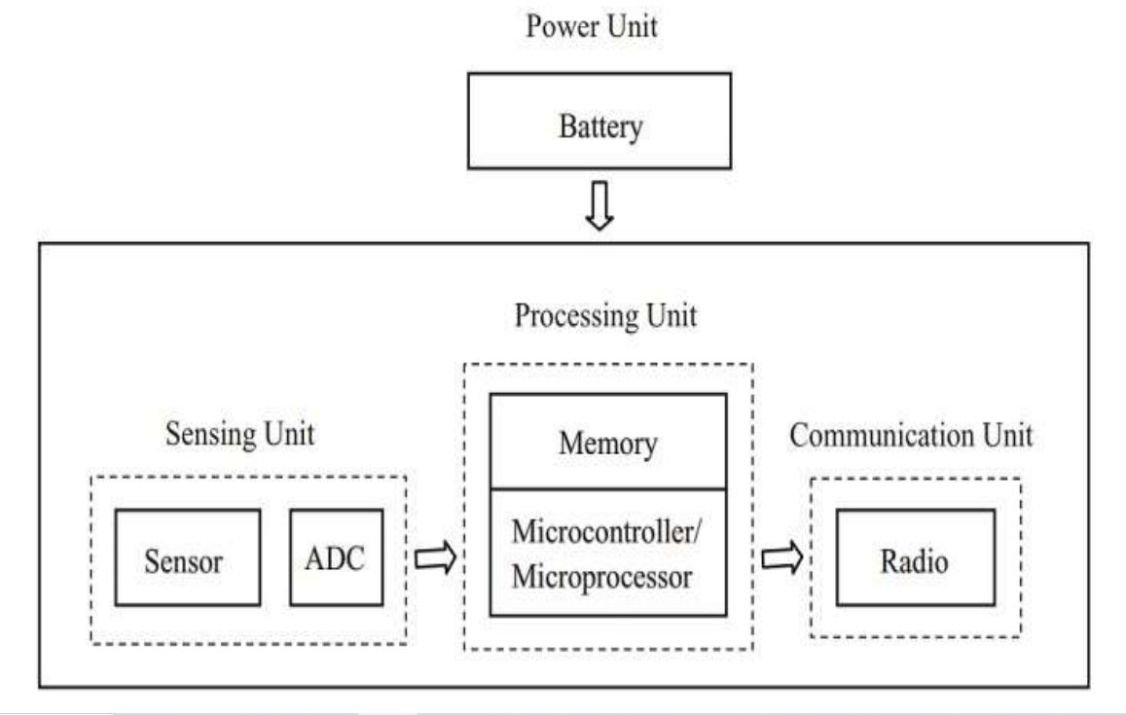
WSN Components

Slide 7
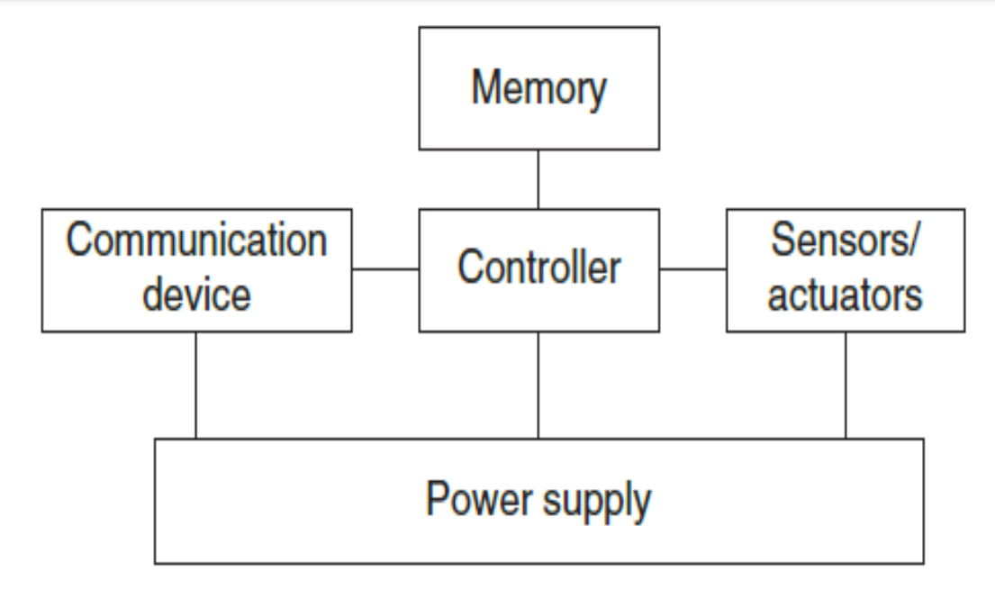
Overview of Sensor Node
Controller: To process all relevant data
Memory: To store programs and intermediate data.
Sensors and actuators: Actual interface to the physical world to observe or control physical parameters of the environment.
Communication: Device for sending and receiving information over a wireless channel
Power supply: Some form of batteries necessary to provide energy and some form of recharging by obtaining energy from the environment as well.

Slide 8
Controller-core of a wireless sensor node.
It is the Central Processing Unit (CPU) of the node
It collects data from sensors, processes this data, receives data from other sensor nodes, and decides on the actuator’s behavior.
It has to execute various programs, ranging from time critical signal processing and communication protocols to application programs.
Microcontrollers are suitable for WSNs since they can reduce their power consumption by going into sleep states where only parts of the controller are active

Slide 9
Memory in WSN
There is a need for Random Access Memory (RAM) to store intermediate sensor readings, packets from other nodes etc.
RAM is fast, but it loses its contents if power supply is interrupted.
The program code can be stored in Read-Only Memory (ROM) or in Electrically Erasable Programmable ReadOnly Memory (EEPROM) or flash memory.
Flash memory can also serve as intermediate storage of data when the power supply goes off for some time.

Slide 10
Communication Module
The transmission medium
radio frequencies
Optical
Communication
ultrasound.
Radio Frequency (RF)-based communication is vital requirement of most WSN applications.
It provides long range and high data rates, acceptable error rates at reasonable energy expenditure
does not require line of sight between sender and receiver.
For a practical wireless, RF-based system, the carrier frequency has to be carefully chosen.
The wireless sensor networks use communication frequencies between about 433 MHz and 2.4 GHz.

Slide 11
Transceivers
For actual communication, both a transmitter and a receiver are required in a sensor node to convert a bit stream coming from a microcontroller and convert them to and from radio waves. Such combined devices are called transceivers.
half-duplex operation is realized since transmitting and receiving at the same time on a wireless medium is impractical in most cases.

Slide 12
Types of Sensors
Passive Omni-directional sensors: They can measure a physical quantity at the point of the sensor node without manipulating the environment by active probing. They obtain the energy directly from the environment – energy is only needed to amplify their analog signal. Typical examples include thermometer, light sensors, vibration, microphones, humidity, chemical sensors etc
Passive narrow-beam sensors: They are passive but have a well-defined notion of direction of measurement. A typical example is a camera, which can “take measurements” in a given direction, but has to be rotated if need be.
Active sensors: They probe the environment, for example, a sonar or radar sensor or some types of seismic sensors, which generate shock waves by small explosions.

Slide 13
Power Supply to sensor nodes
Traditional batteries - The power source of a sensor node is a battery, either non-rechargeable (primary batteries) or, if an energy scavenging device is present on the node, also rechargeable (secondary batteries).
Energy scavenging
Some of the unconventional energy sources like fuel cells, micro heat engines and radioactivity – convert energy from stored secondary form into electricity in a easy way than a normal battery would do.
The entire energy supply is stored on the node itself once the fuel supply is exhausted, the node fails.
The energy from a node’s environment must be tapped into and made available to the node – energy scavenging should take place.

Slide 14
Power Supply to sensor nodes
Photo-voltaics The solar cells can be used to power sensor nodes. The available power depends on whether nodes are used outdoors or indoors, and on time of day.
Temperature gradients Differences in temperature can be directly converted to electrical energy.
Vibrations Walls or windows in buildings are resonating with cars or trucks passing in the streets, machinery often has low- frequency vibrations, ventilations also cause it, and so on.

Slide 15
Applications of WSN
Industrial Process Monitoring
Health Monitoring
Intelligent Agriculture and Environment Sensing
Asset Tracking Supply chain management
Military / security applications
Home Automation

Slide 16
Network Performance Objectives
1. Low Power Consumption
Wireless sensor network applications typically require network components with average power consumption that is substantially lower than currently provided in implementations of existing wireless networks such as Bluetooth.
2. Low Cost
3. Data Throughput
4. Message Latency
5. Security
6. World Wide Availability

Slide 17
Sensor Network Architecture
It can be used in various places like schools, hospitals, buildings, roads, etc for various applications like disaster management, security management, crisis management, etc.
There are 2 types of architecture used in WSN:
Layered Network Architecture,
Clustered Architecture.

Slide 18
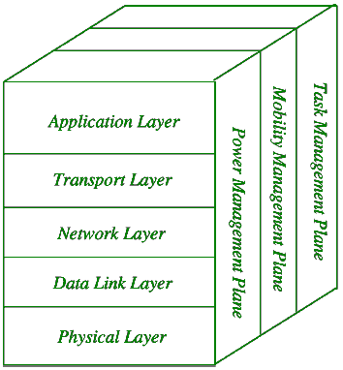
. Layered Network Architecture:
Layered Network Architecture makes use of a few hundred sensor nodes and a single powerful base station. Network nodes are organized into concentric Layers. It consists of 5 layers and three cross layers.
The 5 layers are:
1. Application Layer
2. Transport Layer
3. Network Layer
4. Data Link Layer
5. Physical Layer

Slide 19
Advantages of Layered Architecture
Each node participates only in short-distance, low power transmissions to nodes of the neighbouing nodes because of which power consumption is less as compared to other Sensor Network Architecture.
It is scalable and has a higher fault tolerance.

Slide 20
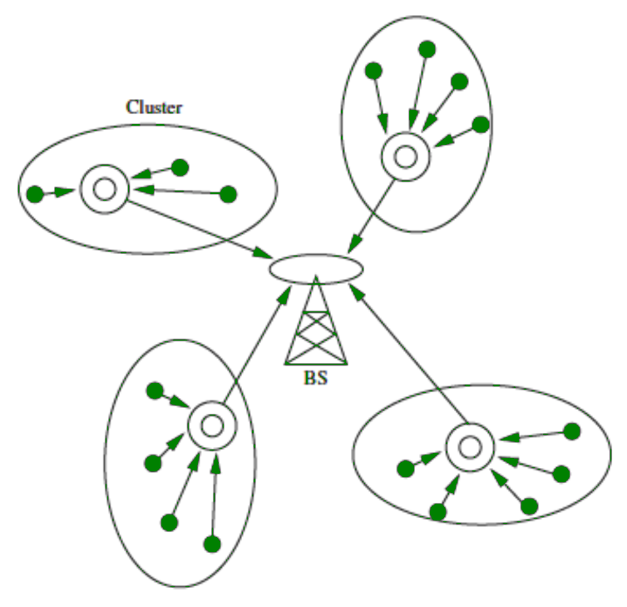
Clustered Architecture
Sensor Nodes autonomously clubs into groups called clusters.
It is based on the Leach Protocol which makes use of clusters.
Leach Protocol stands for Low Energy Adaptive Clustering Hierarchy.
Properties of Leach Protocol:
It is a 2-tier hierarchy clustering architecture.
It is a distributed algorithm for organizing the sensor nodes into groups called clusters.
The cluster head nodes in each of the autonomously formed clusters create the Time-division multiple access (TDMA) schedules.
It makes use of the concept called Data Fusion which makes it energy efficient.

Slide 21
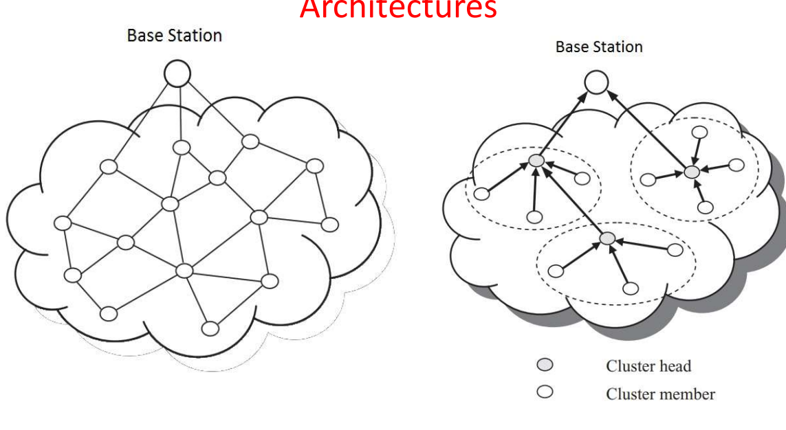
WSN Architectures-Flat and Hierarchical

Slide 22
Types of WSN
Terrestrial WSNs
Underground WSNs
Underwater WSNs
Multimedia WSNs
Mobile WSNs

Slide 23
Topologies in WSN
Star Topology
In star topology, there is a single central node known as hub or switch and every node in the network is connected to this hub.
Star topology is very easy to implement, design and expand.
The data flows through the hub and plays an important role in the network and a failure in the hub can result in failure of entire network.

Slide 24
Topologies in WSN
2. Tree Topology
A tree topology is a hierarchical network where there is a single root node at the top and this node is connected to many nodes in the next level and continues.
The processing power and energy consumption is highest at the root node and keeps on decreasing as we go down the hierarchical order.

Slide 25
Topologies in WSN
3. Mesh Topology
• In mesh topology, apart from transmitting its own data, each node also acts as a relay for transmitting data of other connected nodes.
Mesh topologies are further divided into Fully Connected Mesh and Partially Connected Mesh.
In fully connected mesh topology, each node is connected to every other node while in partially connected mesh topology, a node is connected one or more neighboring nodes.

Slide 26
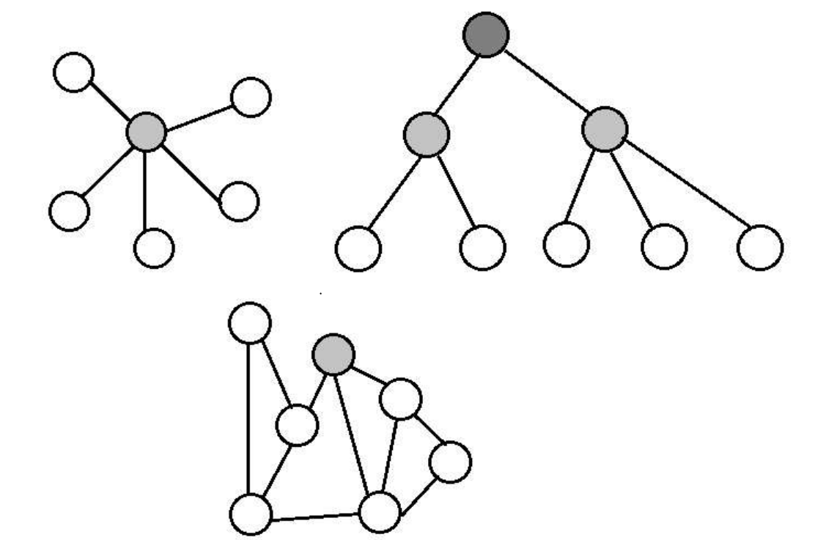
Topologies in WSN

Slide 27
Characteristics of WSN
Type of service
Quality of service
Fault tolerance -The redundant deployment is necessary for WSN to tolerate the node failure and using more number of nodes will be necessary even if all nodes functioned correctly.
Scalability
Lifetime -the time until the first node fails as the network lifetime.
Range of densities -the number of nodes per unit area that is the density of the network
Programmability
Maintainability -WSN has to monitor its own health and status to change operational parameters

Slide 28
Address Centric v//s Data Centric
Address centric - Traditional communication networks are centered around the transfer of data between two devices, equipped with network address
Data Centric –
In a WSN, the nodes are deployed to protect against node failures or to compensate for the low quality of a single node’s actual sensing equipment.
data-centric interaction will be to request the average temperature in a given location area, as opposed to requiring temperature readings from individual nodes.

Slide 29
Routing in WSN
Routing strategies are required for transferring data between the sensor nodes and the base station.
Routing in WSN is different than traditional IP network routing because it exhibits a number of unique characteristics to build a global addressing scheme for a large number of sensor nodes.
Different routing techniques are proposed for remote sensor network and these conventions can be classifiedas per different parameters.

Slide 30
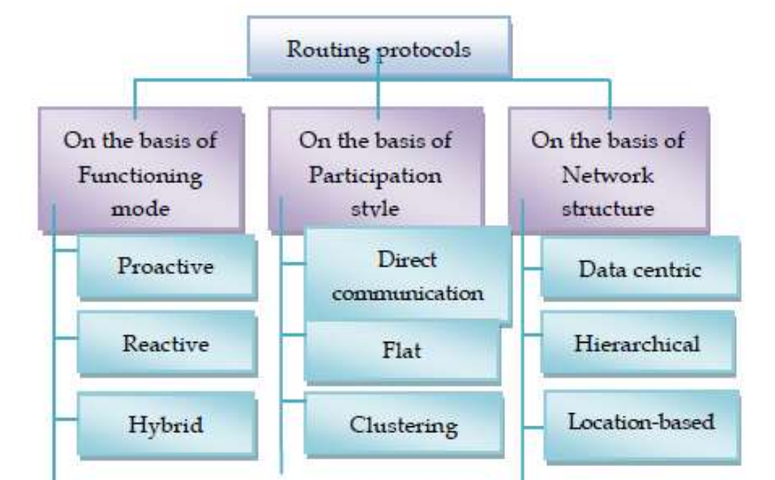
Routing Protocols

Slide 31
Routing types
Direct Communication protocols: In this type of protocols the information sensed by nodes is sent directly to Base Station (BS). Example: SPIN
Flat protocols: In this, the nodes search for the valid path and then transmit it to Base station. Example: Rumor routing protocol.
Clustering Protocols: In this, the area is divided into clusters and Cluster heads are assigned to each cluster. All the nodes in the cluster send data to corresponding cluster heads and then cluster head sends it to Base station. Example: TEEN

Slide 32
Network-based routing protocols
Data Centric protocols: These are query based and they depend on the naming of the desired data. The BS sends queries within a certain region to get information and waits for a reply from the nodes. Nodes in a particular region collect the specific data based upon the queries. Example: SPIN.
Hierarchical protocols: In this, the nodes with lower energy are used to capture information and nodes with higher energies are used to process, transfer it and it is used to perform energy efficient routing. Example: TEEN, APTEEN.
Location Based: In these, the location of nodes must be known to find an optimal path using flooding. To get the information about location of a particular node GPS is used. Example: GEAR.

Slide 33
Routing Types
Energy efficiency of a network is a significant concern in wireless sensor network. These days networks are becoming large, information gathered is becoming larger, which all consume a great amount of energy resulting in an early death of a node.
Therefore, many energy efficient protocols are developed to lessen the power used in data sampling and collection to extend the lifetime of a network.
The following are some of energy efficient routing protocols:
LEACH
PEGASIS
TEEN

Slide 34
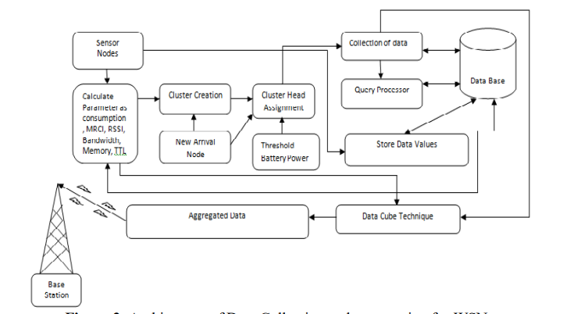
Data Collection and Aggregation

Slide 35
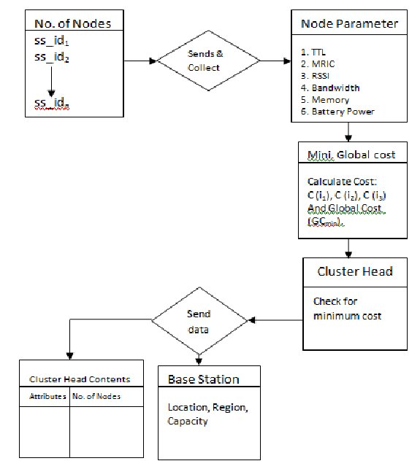
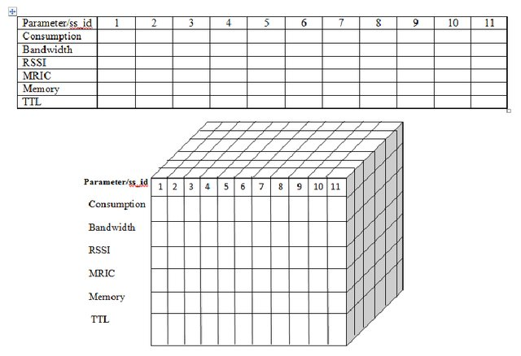
Data Cube Technique of Aggregation

Slide 36
Data Aggregation: Working Principle
starts working by choosing selecting of nodes and divided into clusters. These clusters can satisfy the intended parameter requirements and conditions. The parameters like RSSI, TTL, MRIC, bandwidth, battery consumption are accustomed verify the amount of nodes that will be considered in a cluster.
a cluster head (CH) is selected among nodes lies within the each cluster. CH are going to be responsible for administration of all different nodes inside several cluster and collecting the data} from the nodes within the cluster and transferring the information to the neighboring cluster head for more information exchange and updation .
The newly arrived nodes will be assigned as cluster head if the global cost of arrived node is minimum , otherwise other cluster nodes are going to be given opportunity to participate and global cost is once more recalculated.
thereafter the data aggregation approach is presumed as the collection of data and numerous queries from the user end are checked and transformed into low level schemes by a query processor.
All data collected and aggregated is stored at a storage location in database server.

Slide 37
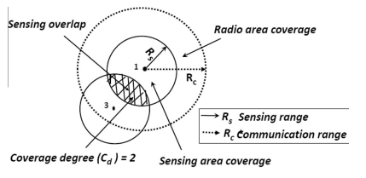
Sensing and Communication range of sensor node
The sensing area coverage (or sensing coverage) is the region that a node can observe or monitor within its sensing range.
The network coverage could be interpreted as the collective coverage by all the ACTIVE sensor nodes in the WSN.
sensor node has a radio area coverage based on its communication range (Rc). The radio coverage bounded by Rc, is the region or area within which an ACTIVE sensor node can communicate with at least one other sensor node.
Sensing coverage ensures proper event monitoring while radio coverage ensures proper data transmission within the WSN
Coverage degree (Cd) refers to the number of sensor nodes actively monitoring an area. Cd = n means n sensors are actively monitoring an area.
Sensing void or hole occurs when no sensor actively monitors an area.
To maximize the network lifetime it is essential to minimize the number of ACTIVE nodes while still achieving maximum possible sensing and radio coverage

Slide 38
Coverage
Sensors are prone to be failure.
The over-loading of working sensor nodes will cause easily exhausted and failed.
In addition to possible hardware or software malfunctions, sensors may fail because of severe weather conditions or other hash physical environment in the sensor filed.
It is therefore crucial to construct a fault-tolerant WSN that will continuously provide needed services despite sensor failures. This is the fault-tolerance requirement.

Slide 39
Coverage
The fault-tolerance requirement includes two types:
coverage fault-tolerance
connectivity fault-tolerance.
The sensor coverage problem can be further divided
single coverage - In single coverage, each target or point in the area must be monitored by at least one working sensor
multiple coverage - In multiple coverage, each target or point in the area needs to be monitored by at least k different working sensors, which is called as the flat k-area-coverage problem for area coverage.

Slide 40
Area Coverage Problem
A set of sensors are given and distributed over a geographical region to monitor a given area, an area coverage problem is to find a minimum number of sensors to work such that each physical point in the area is-
monitored by at least a working sensor.

Slide 41
Connected Area Coverage Problem
A set of sensors are given and distributed over a geographical region to monitor a given area, an m-connected k-coverage problem is to find a minimum number of sensors to work such that each physical point in the area is-
monitored by at least k active sensors and
the active sensors form a m-connected graph

Slide 42
PEAS(probing environment and adaptive sleeping ), a distributed, probing-based density control algorithm for robust sensing coverage.
A subset of sensor nodes operative mode maintains coverage while others are put into sleep.
Each sensor node has the same probing range Rp and may vary its transmission power and choose a power level to cover a circular area given a radius.
In PEAS, each node has three operation modes:
sleeping, probing and working.
Initially all sensor nodes are in the sleeping mode. Each node sleeps for an exponentially distributed duration generated according to a probability density function (PDF).
When sleeping time expires, the sensor enters the probing mode.
The probing node uses an appropriate transmission power to broadcast a PROBE message within its local probing range Rp.
Any working node(s) within that range should respond with a REPLY message, also sent within the range of Rp. If the probing node hears a REPLY, it goes back to the sleeping mode for another random period of time.
If the probing node does not hear any REPLY, it enters the working mode and starts monitoring until it fails or consumes all its energy

Slide 43
Clustering of Sensors
Clustering of nodes plays an important role in conserving energy of WSNs.
Clustering approaches focus on resolving the conflicts arising in effective data transmission.
Modern energy-efficient clustering approaches to improve the lifetime of WSNs.
(i) fuzzy-logic-based cluster head election,
(ii) efficient sleep duty cycle for sensor nodes,
(iii) hierarchical clustering, and
(iv) estimated energy harvesting.
Classical clustering approaches such as low energy adaptive clustering hierarchy (LEACH) is used.

Slide 44
LEACH
LEACH is a hierarchical protocol in which most nodes transmit to cluster heads, and the cluster heads aggregate and compress the data and forward it to the base station (sink).
Each node uses a stochastic algorithm at each round to determine whether it will become a cluster head in this round.
LEACH assumes that each node has a radio powerful enough to directly reach the base station or the nearest cluster head, but that using this radio at full power all the time would waste energy.
LEACH also uses CDMA so that each cluster uses a different set of CDMA codes, to minimize interference between clusters.
LEACH addresses the overloading of clusters and it rotates the role of cluster heads among the sensor nodes present in a cluster.
The significant drawback of this approach is that no weightage is given for the residual energy of the sensor nodes.

